Slide 1



SAS Project 3
Payal Vaidya fall 2023

Slide 2
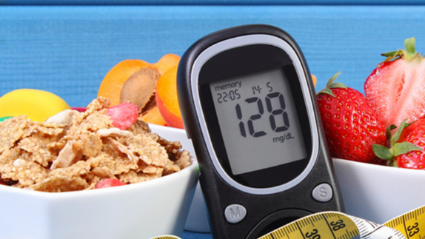
Introduction: A study is conducted to determine whether drug A is reducing blood sugar levels. There are 3400 patients enrolled for this study. Patients come from two different states Arizona and California.

Slide 3

Objectives: A study was conducted to determine whether a “DRUG A” helps to reduce fasting sugar levels. patients enrolled for this study and before and after fasting sugar levels were taken at specific intervals. My objectives are to know how Factors like Age and state affect blood sugar levels. Investigate the relationship between "DRUG A" administration and variations in fasting sugar levels both before and after treatment. Determine whether the research population's fasting sugar levels varied significantly before and after "DRUG A" was administered. Examine the study population's fasting blood sugar levels in various states to see whether there are any patterns or trends. Based on the study's findings, suggest possible modifications or enhancements to the way "DRUG A" is administered.

Slide 4
Question:1
Does Drug A lower blood sugar levels both before and after fasting?
Question:2
The investigation aims to determine if patients' mean fasting blood sugar levels equal 100.
Question-3 After drug A is administered, are there any mean differences in the fasting blood sugar levels between Arizona (AZ) and California (CA)?
Question-4 Is there any difference in the mean of "After Blood Sugar" readings among the age groups?
Question-5 Is there an interaction impact of age and state on the fasting blood sugar level?
Question-6 Is there a relationship between age and blood sugar levels before and after?
Question-7 How can the relation between blood sugar levels before and after be visually represented using a scatter plot?

Slide 5
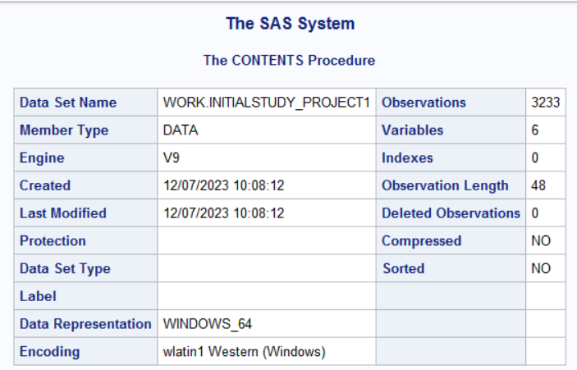
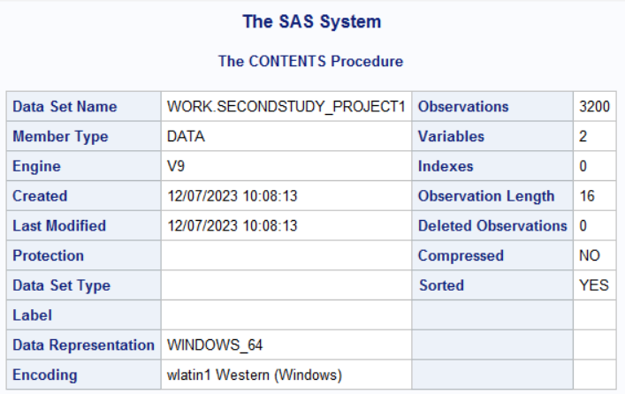
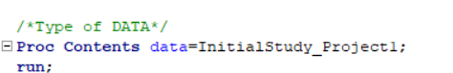
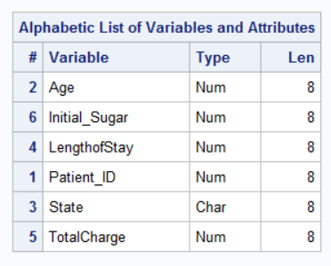
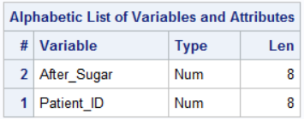
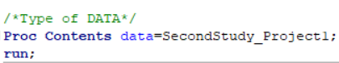

Slide 6
Data cleaning Steps | Project File 1 | Project File 2
Excel File to comma-delimited CSV file to a text file to be imported into the SAS environment. | 3233 observations and 6 variables are seen | 3200 observations and 2 variables are seen
I Run the Proc frequency procedure to find any discrepancies in data. | Where I can see missing data Age-16 Length of stay-2 total charge-205 | No Missing data No Junk data
Deleted all missing data of Age Length of stay and Total Charge | 3012 with 6 Variables left. | 3200 observation as it is.
Sorted both files with the Common Variable of Patient_ID | Patient_ID | Patient_ID
Merge Both files (Inner joint) Rename Variables, create new Variables, and Drop Variables. | After merging both files 2975 observations and 7 variables. | I have 1000 Sample sizes after SRS sampling.

Slide 7
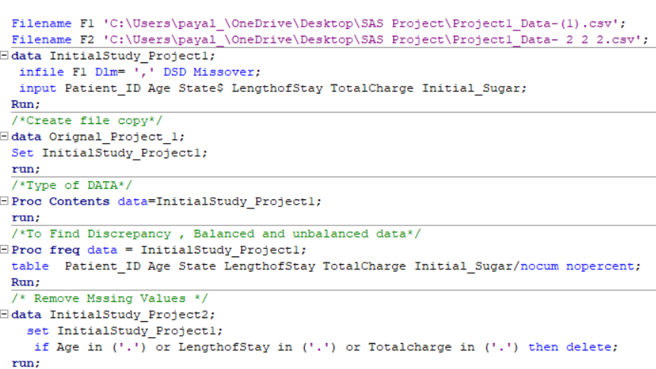

Slide 8
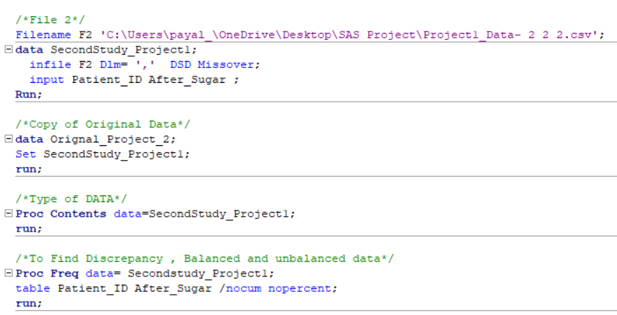

Slide 9
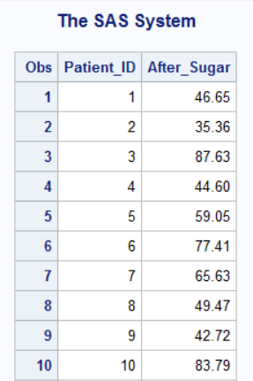
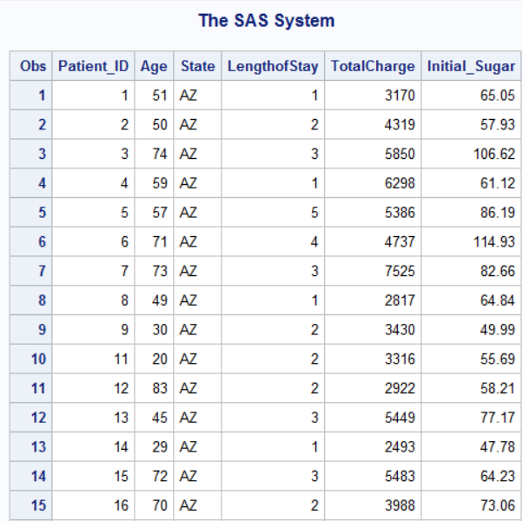

Slide 10
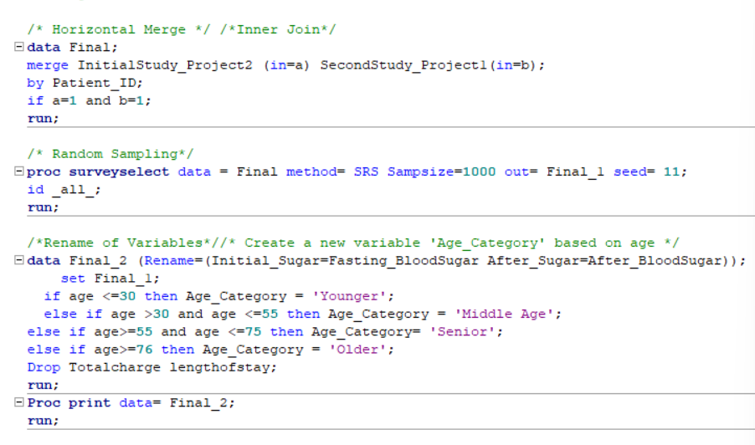

Slide 11
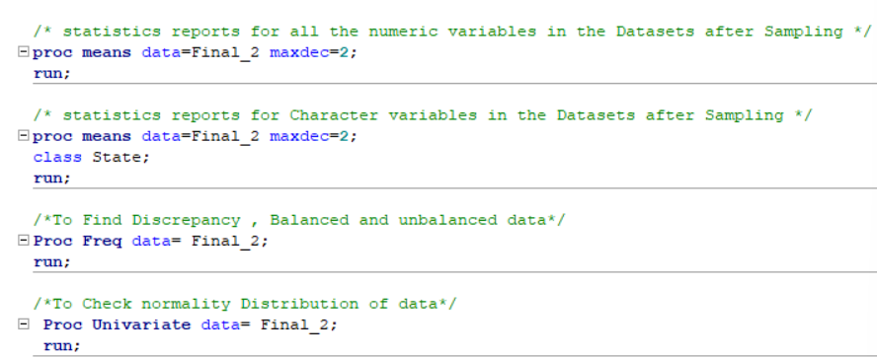

Slide 12
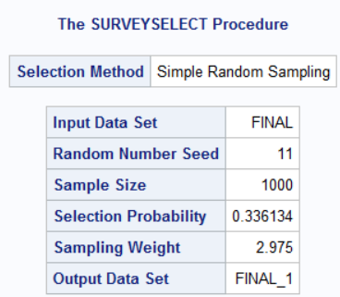
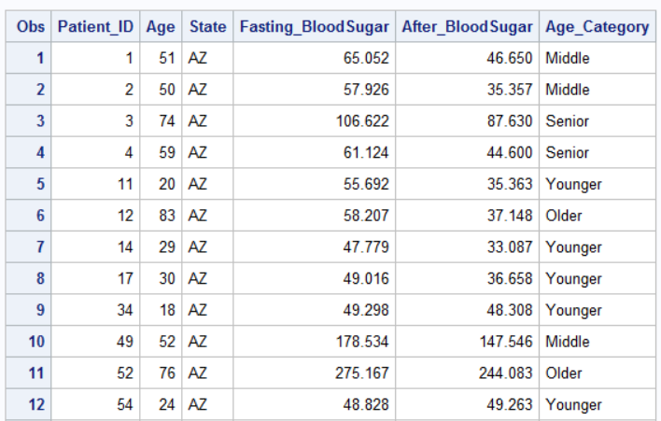
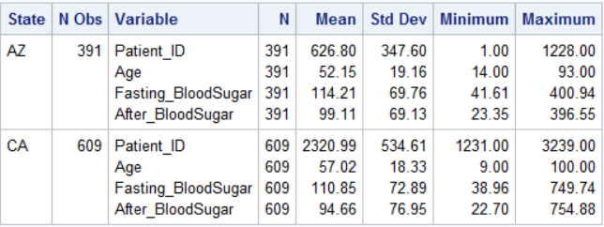
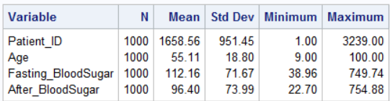
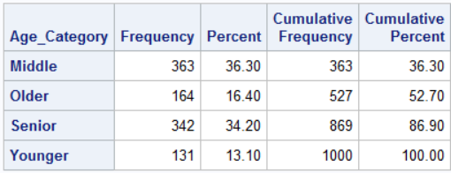

Slide 13
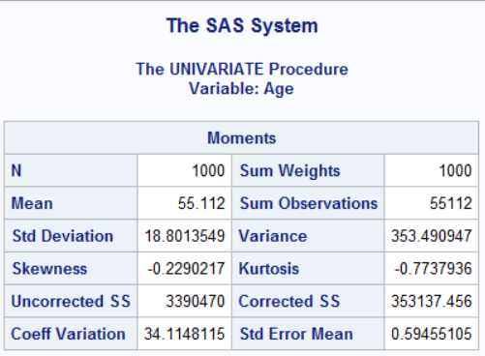
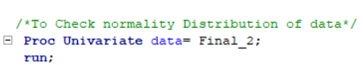
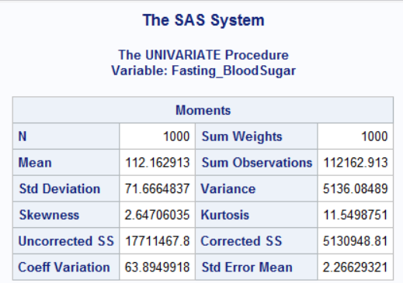
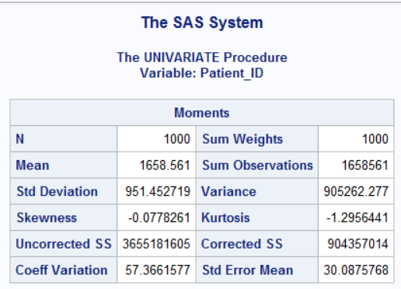
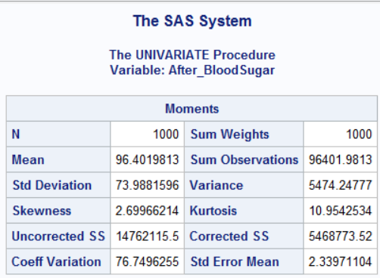
The code performs a univariate analysis of the dataset Final_2 using the Proc Univariate technique, providing information on the data's normality distribution. Based on the findings, we're going to assume that the data is normally distributed and execute additional code to analyze the study questions.

Slide 14
Objective: Using a paired t-test, compare the fasting sugar levels in the same group of patients before (Fasting_bloodSugar) and after (After_bloodSugar) the administration of "DRUG A". Steps: First, define hypotheses. Hypothesis Null (H0): Yes, Drug A lowers blood sugar levels both during and after fasting. The alternative hypothesis (HA): No, Drug A does not lower blood sugar levels both during and after fasting. Step 2: Examining Hypotheses To investigate the hypotheses, run a paired t-test using SAS.
Question-1 Question:1
Does Drug A lower blood sugar levels both during and after fasting?

Slide 15
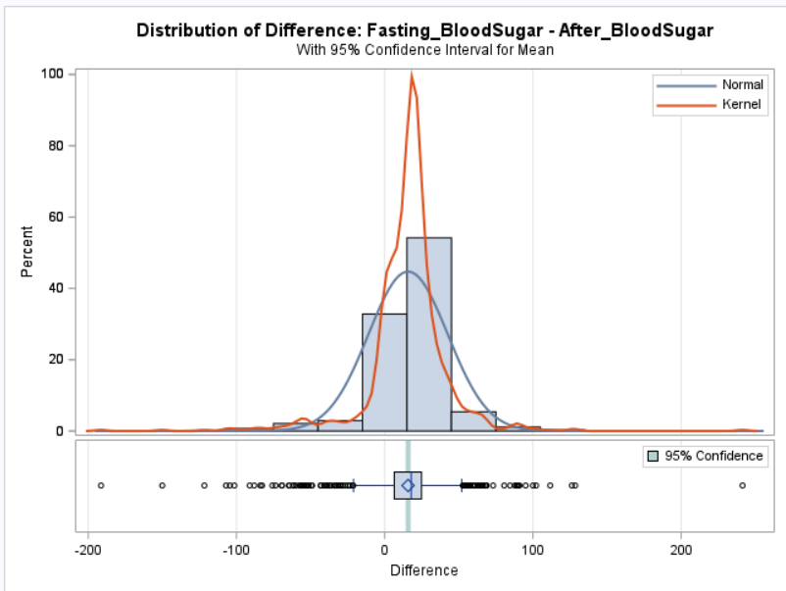
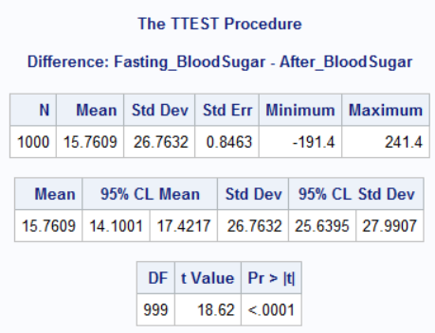
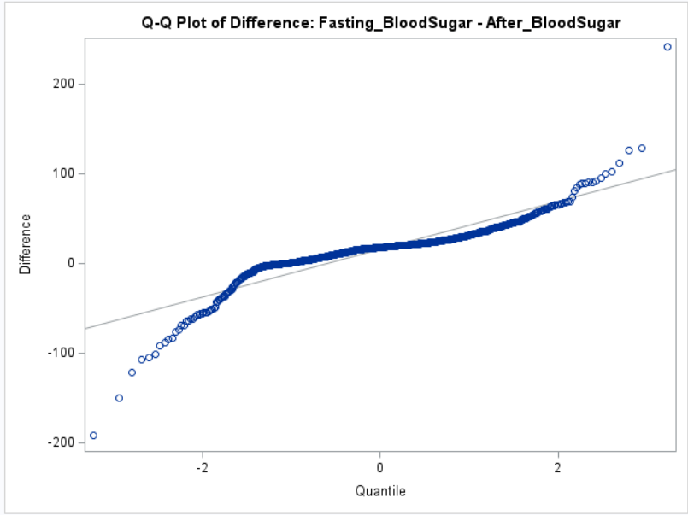
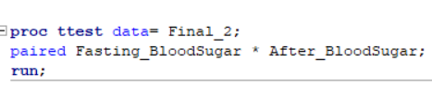

To determine whether there is a statistically significant difference in fasting sugar levels before and after the administration of "DRUG A" within the same group of patients, the paired t-test is the suitable statistical test. There's significant evidence against the null hypothesis, as indicated by the very small p-value then 0.05 (Pr > |t| < 0.0001). As a result, we are going to conclude ): No, Drug A does not lower blood sugar levels both during and after fasting.

Slide 16
Question-2
The investigation aims to determine if patients' mean fasting blood sugar levels are equal to 100.
The null hypothesis will be (H0) Mean result Mean Fasting blood sugar level is equal to 100
The alternative hypothesis will be (Ha) Mean Fasting blood sugar level is not equal to 100
To investigate the hypotheses, run a proc t-test using SAS.

Slide 17
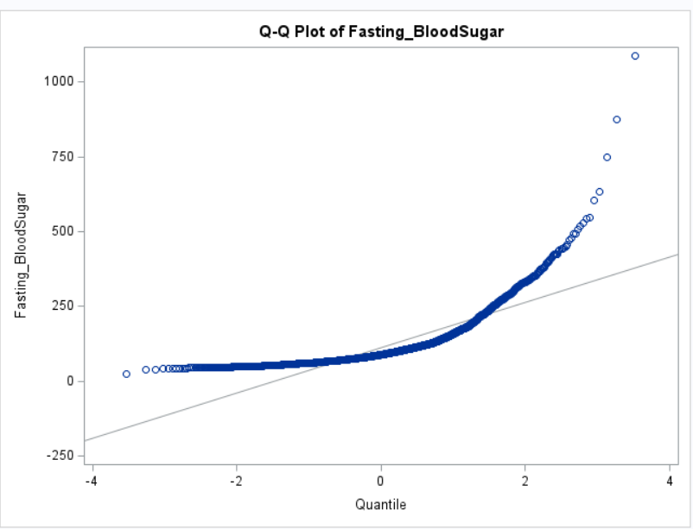
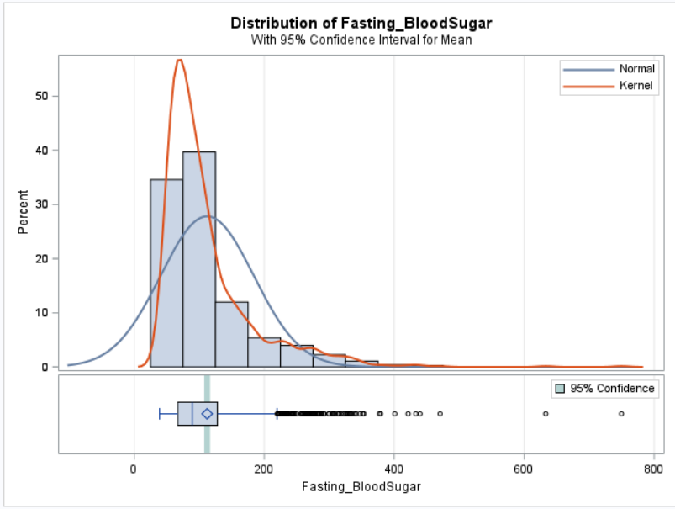
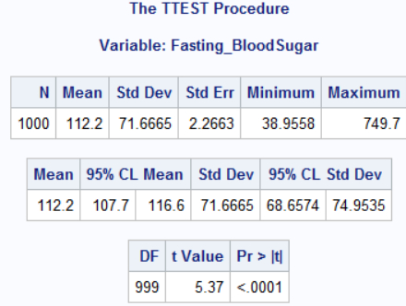
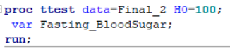
We expect a mean of 100 here we can see 112.3 which is different than 100. The P value is 0.0001 which is much lower than 0.05 which indicates strong evidence of rejecting the null hypothesis. we can say that the blood sugar level is different than 100.

Slide 18
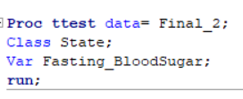
Research Question-3 After drug A is administered, are there any mean differences in the fasting blood sugar levels between Arizona (AZ) and California (CA)? Fasting Blood Sugar = Dependent Variable States = Independent Variable The alternative hypothesis will be (Ha): There is a mean difference between the two states. The null hypothesis will be (H0): there is no mean difference between the two states. To investigate the hypotheses, run a two-sample t-test using SAS. Check whether data is normally distributed or not also check the equality of variance. Assuming the data is normally Distributed.

Slide 19
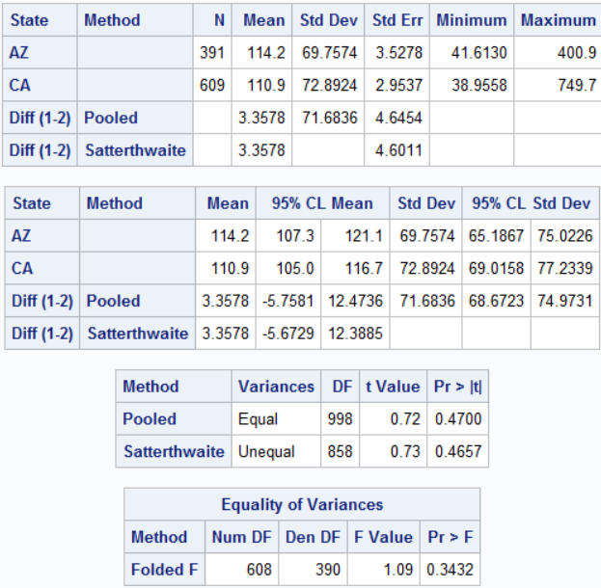
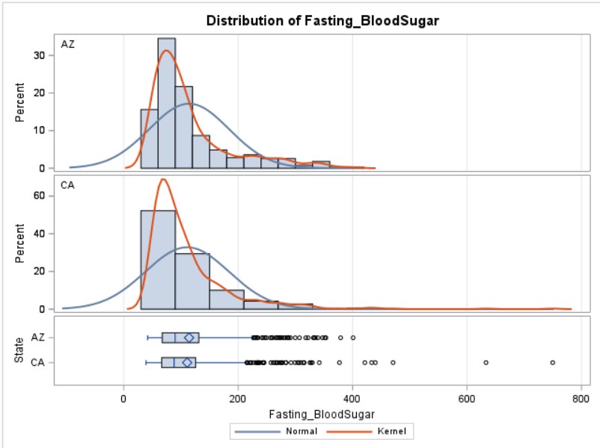
The equality of variance P value is 0.3, greater than 0.05. which indicates that the null hypothesis is true for the equality of variance. In the case of equality of variance check the pooled P value, which is 0.4 greater than 0.04 hence we accept the null hypothesis which says that there is no mean difference in fasting blood sugar between the two states.

Slide 20
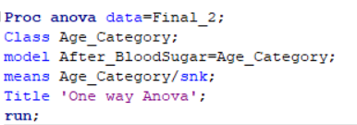
Research Question-4 Is there any difference in the mean of "After_BloodSugar" readings among the age groups? I am assuming a normal distribution of the data. Test: Hypothesis for the comparison of independent age groups are: Null Hypothesis: No difference in Means of fasting blood sugar among all age groups. Alternative hypothesis: difference in Means of fasting blood sugar among all age groups. Test hypothesis using SAS one-way ANOVA. Variables: Age_Categories: Independent variable After_blood sugar level: Dependent variable.

Slide 21
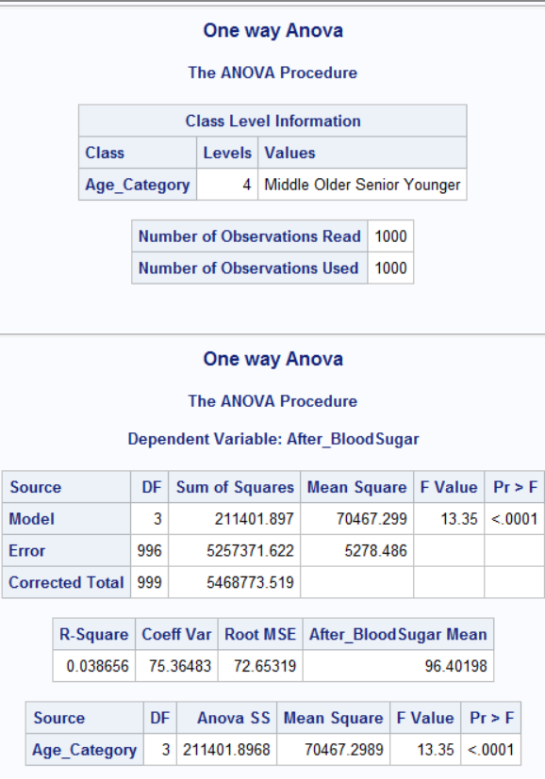
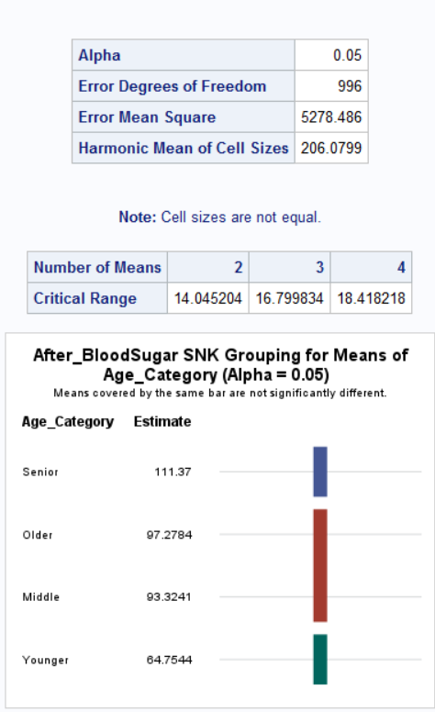
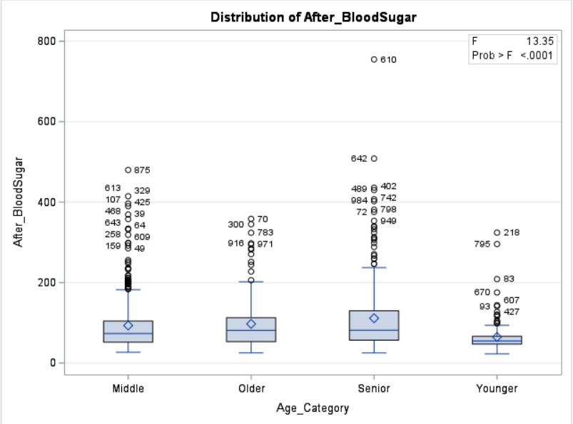
The p-value is 0.001 which is smaller than 0.05 hence we accept the alternative hypothesis and reject the null hypothesis, and hence we can conclude that there is an after-blood sugar level difference among age categories. On seeing the SNK graph, I can say that the old age and middle age group shows higher After blood sugar levels compared to the young age group.

Slide 22
Question-5 Is there an interaction impact of age and state on the fasting blood sugar level? we have an unequal number of subjects in each category (unbalanced and hence we use PROC GLM instead) Two-way ANOVA Fasting Blood Sugar = Dependent Variables. Age=independent Variables. State=Independent Variables.
To check the interaction impact, we are going to run the proc glm procedure.
Here I assume that the data is normally distributed.
#Null Hypothesis: There is no interaction impact of age and state on Fasting blood sugar level.
# Alternative Hypothesis: There is an interaction impact of age and state on Fasting blood sugar level.

Slide 23
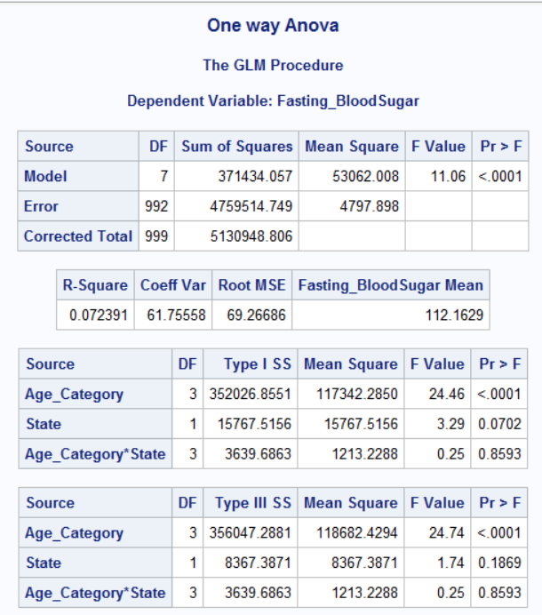
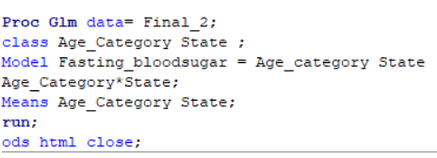
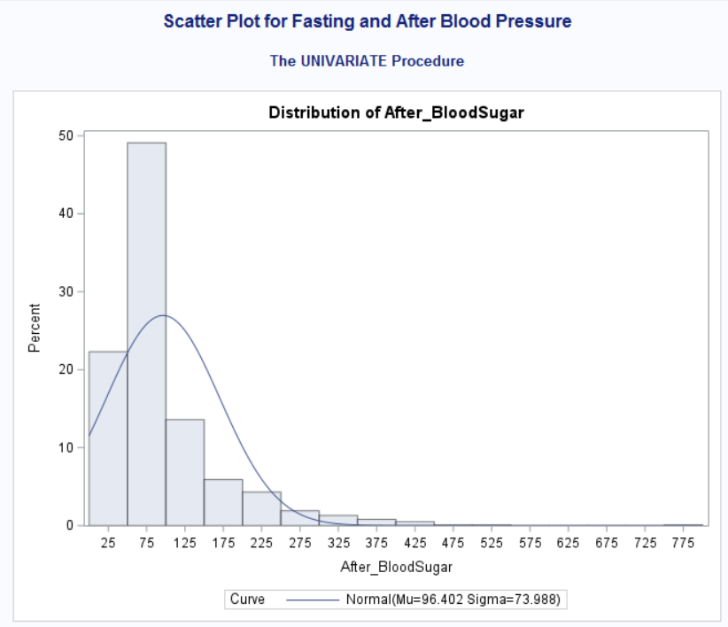
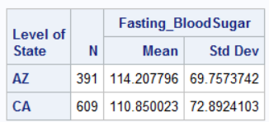
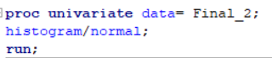
The P-value is 0.001, which is smaller than 0.05, we can reject the null hypothesis. This indicates there is an interaction impact of age and state on Fasting blood sugar level. P value 0.0001 for age which is smaller than 0.05 which indicates interaction on fasting blood sugar level and P values of 0.8 greater than 0.05 for Age and state do not have an interaction impact of age and state on Fasting blood sugar level.

Slide 24
I run proc univariate and check whether data is normally distributed or not. Assuming data is normally distributed. Hypothesis: H0 (Null Hypothesis): There is no linear relationship between the After-blood sugar level and the before-blood sugar level. Ha(Alternative Hypothesis): There is a linear relationship between relationship between After blood sugar level and before-blood sugar level
Question-6 Is there a relationship between age and blood sugar levels before and after?

Slide 25
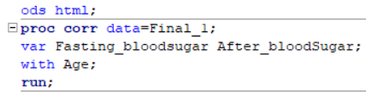
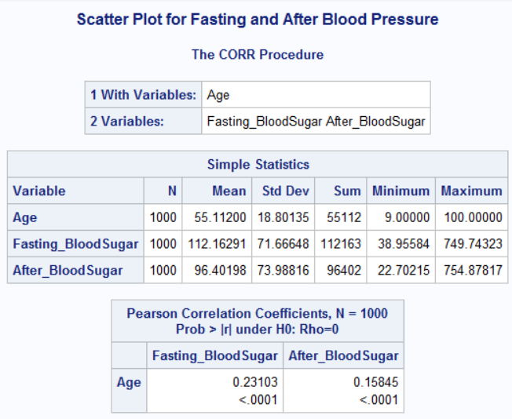
For the relation of "Age" between "Fasting_BloodSugar" and "After_BloodSugar," Pearson correlation coefficients are given. "Age" and "Fasting_BloodSugar" have a (p <.0001) association."Age" and "After_BloodSugar" have a (p <.0001) association. Which is smaller than 0.05 so we can accept the alternative hypothesis. There is a relation of age between fasting and after-blood sugar levels. In conclusion, there is a statistically significant positive association between blood sugar levels measured both before and after fasting with age.

Slide 26
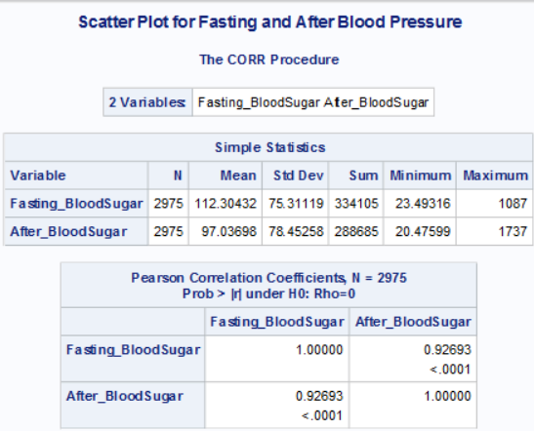
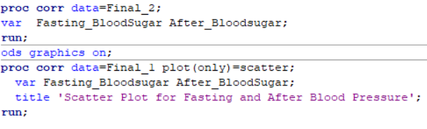
Question-7 How can the relation between blood sugar levels before and after be visually represented using a scatter plot?

Slide 27
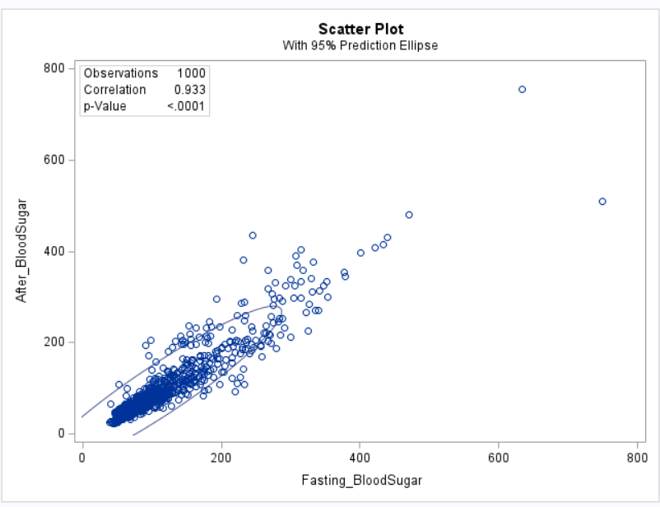
There is a significant positive relationship (p <.0001) between "Fasting_BloodSugar" and "After_BloodSugar" according to the correlation value of 0.933 To summarize, the scatter plot displays the relationship between blood sugar levels after fasting and fasting, and the correlation coefficients provide quantitative evidence of a high positive correlation between the two variables.

Slide 28
Question:1
Does Drug A lower blood sugar levels both during and after fasting?
Answer:
“ No, Drug A does not lower blood sugar levels both during and after fasting.
Question:2
The investigation aims to determine if patients' mean fasting blood sugar levels equal 100.
Answer:
we can say that the blood sugar level is not equal to 100.
Question-3 After drug A is administered, are there any mean differences in the fasting blood sugar levels between Arizona (AZ) and California (CA)?
Answer: “ NO there is no mean difference in fasting blood sugar between the two states”
Question-4 Is there any difference in the mean of "After Blood Sugar" readings among the age groups? Answer: “Yes, there is an after-blood sugar level difference among age categories.”
Question-5 Is there an interaction impact of age and state on the fasting blood sugar level?
Answer: “Yes there is an interaction impact of age and state on Fasting blood sugar level”
Question-6 Is there a relationship between age and blood sugar levels before and after?
Answer: ‘Yes, there is a relation of age between fasting and after-blood sugar levels.
Question-7 How can the relation between blood sugar levels before and after be visually represented using a scatter plot?
Answer: “Yes we can Display a relation between blood sugar levels before and after”

Slide 29

